Slide 1
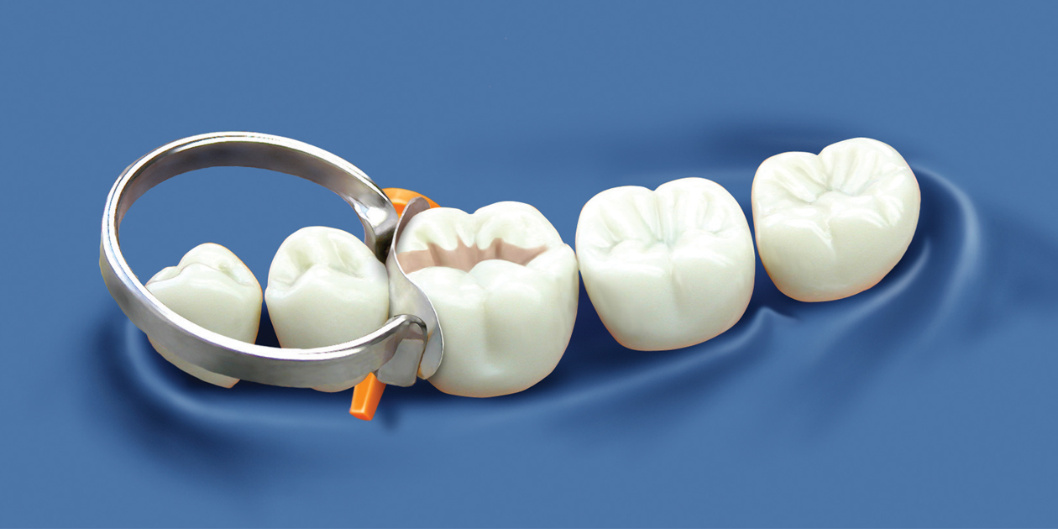
CONSERVATIVE INSTRUMENTS
Dr. KaramAhmed

Slide 2
Operative Dentistry Conservative Dentistry
It’s the art and science of diagnosis, treatment and prognosis of defects of teeth. Such treatment should result in:
Goals
Restoration of proper tooth form.
Function.
Esthetic.
Maintain physiological integrity and harmonious relation with surrounding tissues.

Slide 3
History
Previously was a just a practice not based on scientific knowledge.
Louis Pasteur (France) Role of MO in disease.
G.V Black (USA, 19th) related the clinical practice to scientific bases.

Slide 4
Indications
Indications are numerous, but can be categorized into the following primary needs:
Caries.
Malformed teeth.
Discolored teeth.
Fractured teeth.
Replacement or repair of previous restorations.

Slide 5
Considerations
Infection control.
Examine oral and systemic health of pt not only the affected tooth.
Oral manifestation of other diseases.
Understanding of restorative material properties.
Understanding of oral environment to which the restoration placed.
Understanding of biological bases and function of the various tooth component and supporting structures.
Knowledge of correct dental anatomy.
Effects of operative procedures on the treatments of other disciplines.
Treatment plane.

Slide 6
CLASSIFICATIONS..

Slide 8
Instrument Nomenclature
Function: e.g. condensers, carvers, cutting inst. ……. etc.
Manner of use: hand condenser, mechanical condenser …
Design of working end: spoon excavator, sickle scaler.
Angulations of the shank: mon-angle, bin-angle, triple…

Slide 9
General classification of hand instruments
1. diagnostic instruments. 2. isolation of operating field instruments. 3. manipulation of restorations instruments. 4. carver instruments.
5. finishing and polishing instruments. 6. cutting instruments.

Slide 10
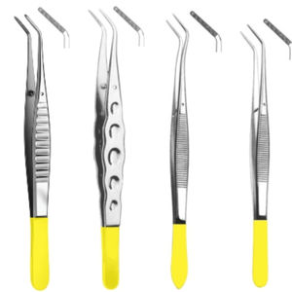
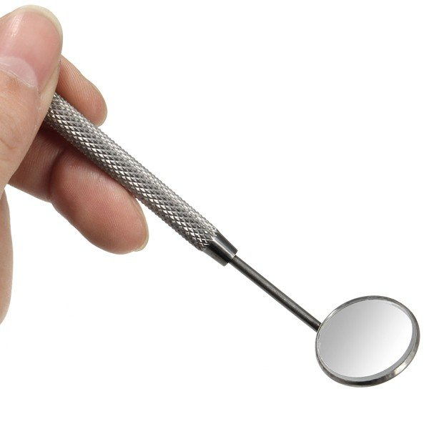
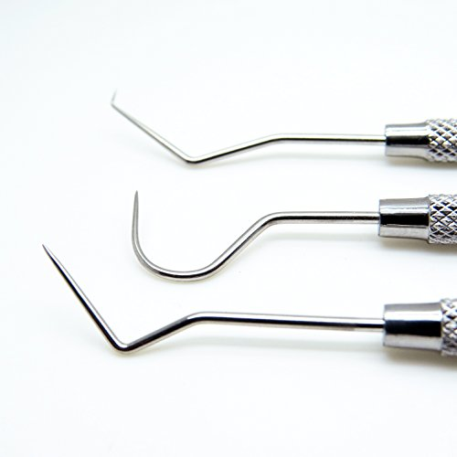
1. Diagnostic instruments
Used for inspection and exploration of both teeth and surrounding soft tissue ex: mirror,probe and tweezers…etc

Slide 11
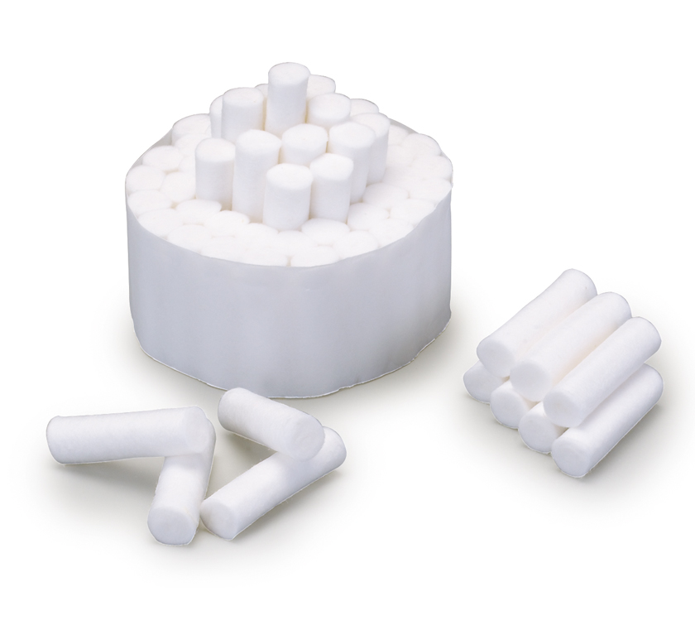
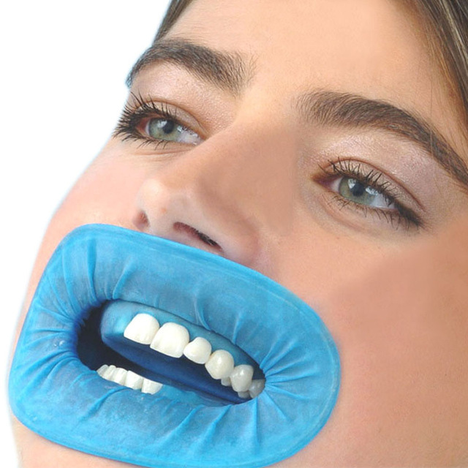
2. isolation of operatiing field instruments.
Manuals: by absorbents e.g: cotton rolls or pellets and rubber dam

Slide 12
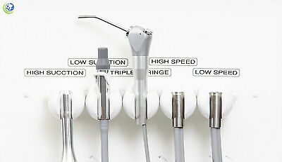
Mechanical: by low and high suction

Slide 13
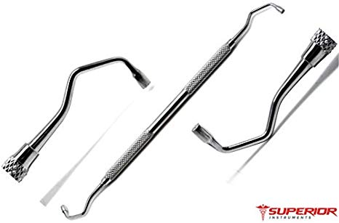
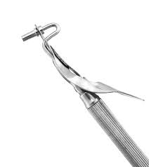
3. manipulation of restorations instruments.
Condensing : used in packing and condensation e.g: amalgam condenser and carrier

Slide 14
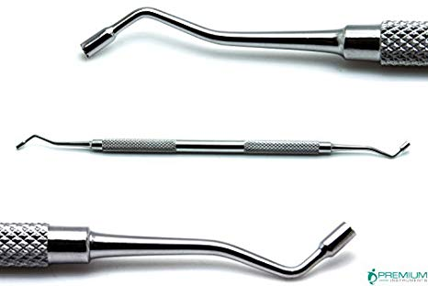
Pluggers
Pluggers are also known as amalgam condensers. They are used to achieve a well condensed filling by compressing the filling material into the cavity and applying pressure.

Slide 15
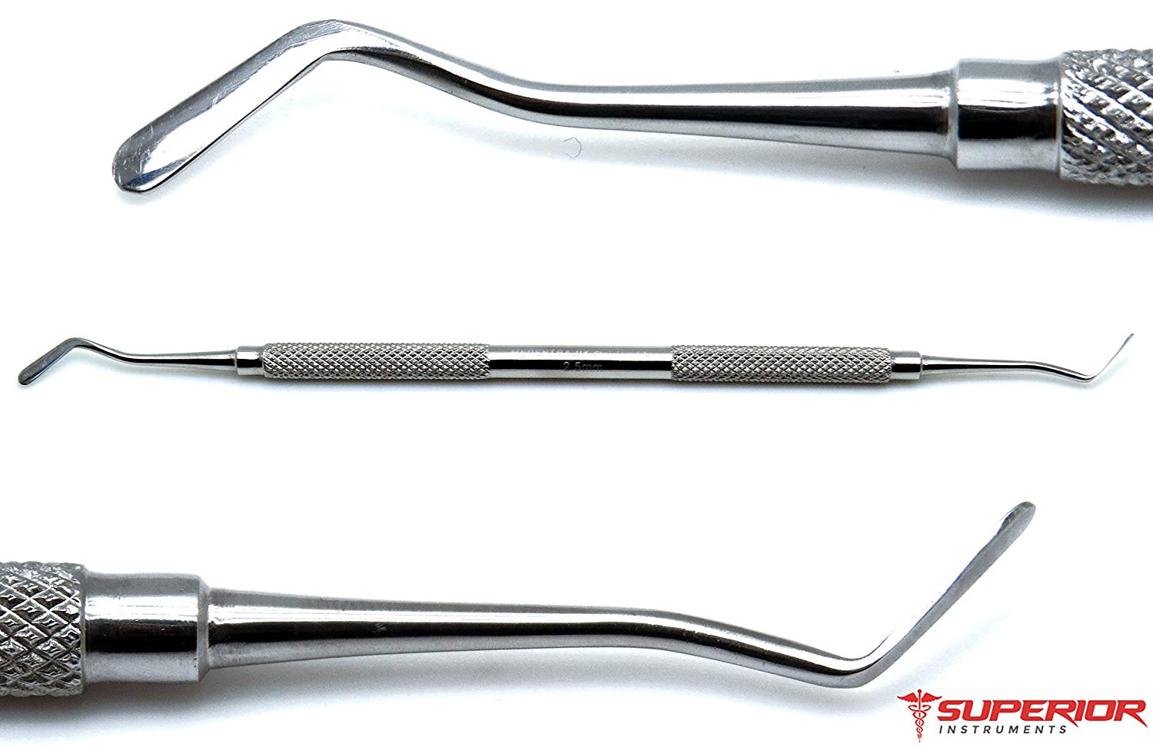
Plastic instruments: instruments used in manipulation of restorative materials made from metal and used with composite

Slide 16
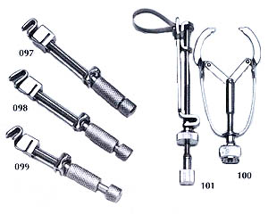
Matrices: instruments used with class2 cavity, aiming to support the material to prevent it during it’s packing from escaping outside the cavity . ivory and tofflemire:

Slide 17
Palodent composite matrix :

Slide 18
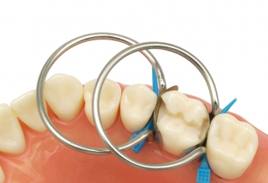
bitine rings:

Slide 19
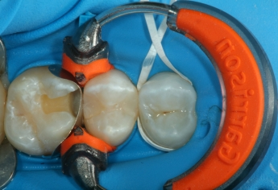
Composite tight ring:

Slide 20
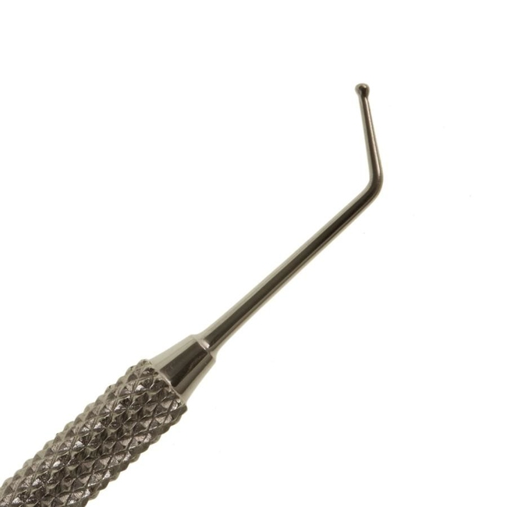
Non cutting instruments
Dycal applicator : to place calcium hydroxide or glass ionomer in cavity preparation

Slide 21
A dappen glass (also called Dappen Dish) is a small, dense glass or ceramic vessel which has each end ground or hollowed out to provide a bowl for mixing substances. Generally these dishes have ten equal walls (decagon) with a large bowl on one side and a smaller bowl ground out on the other.

Slide 23
Cement Spatula. This non-rusting, stainless steel cement spatula is excellently suited for mixing cement, filling materials and small quantities of impression materials. The double-ended mixing spatula consists of one flat, straight functionalend and one flat, tapered functional end.

Slide 25
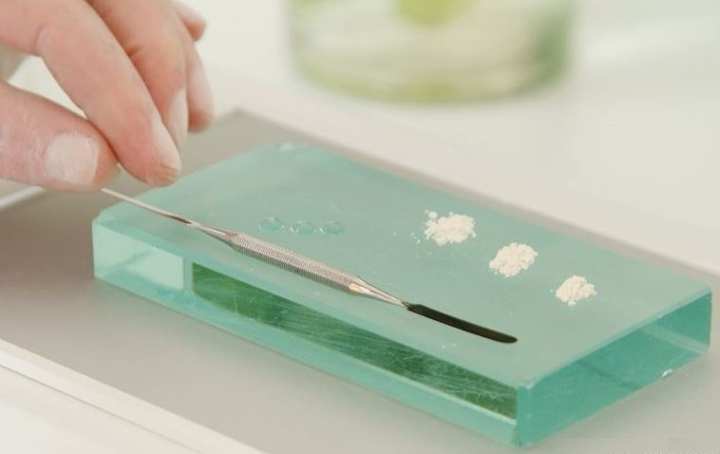
Glass slap: for mixing.

Slide 26
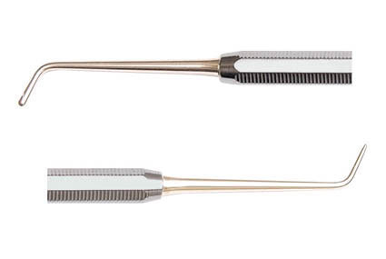
Ash 49: for restoration.

Slide 27
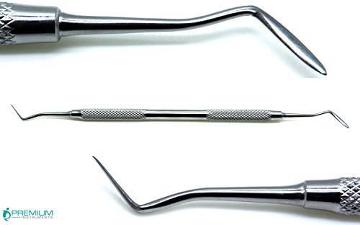
4.Carving instruments
Used to establish the anatomical form of restoration surface, the most common: Hollenbeck carver and ball burnisher.

Slide 28
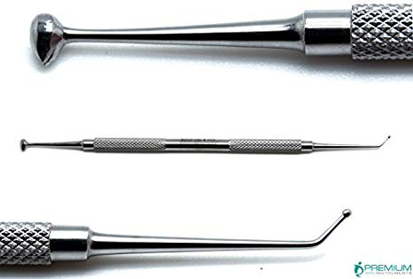
Burnisher

Slide 29
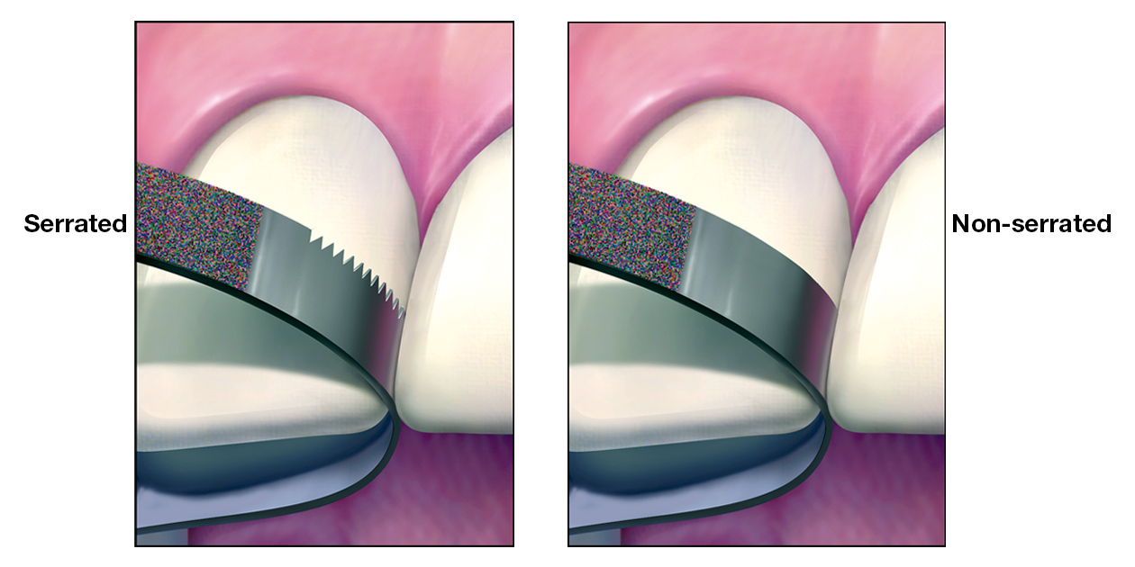
5.Finishing and polishing instruments:
Hand e.g. finishingstrips (removes overhang and flashes of restorations)

Slide 30
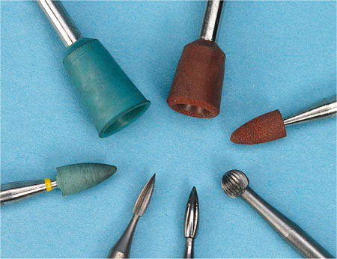
Rotary e.g. finishing burs, finishing stones, sand paper disc, sof-lex discs, black bristle brush, and rubber cups (are used for polishing of amalgam restoration).

Slide 31
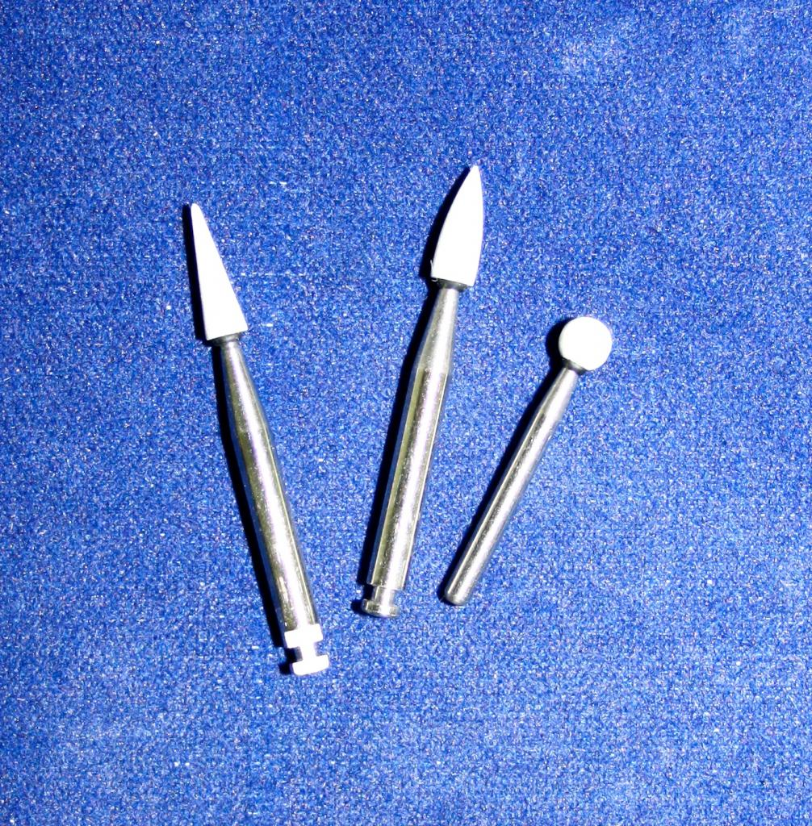
Finishing stone:

Slide 32
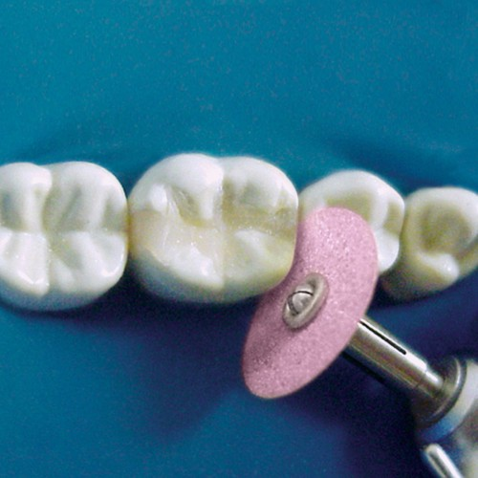
sand paper disc:

Slide 33
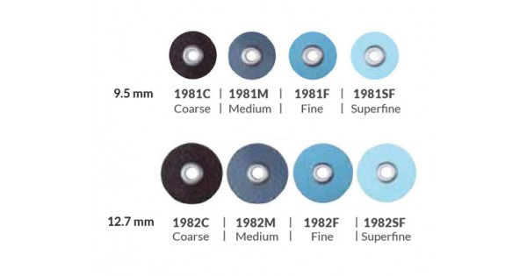
sof-lex discs:

Slide 34
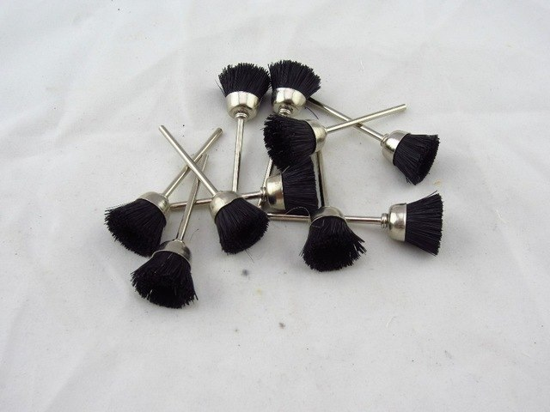
black bristle brush:

Slide 35
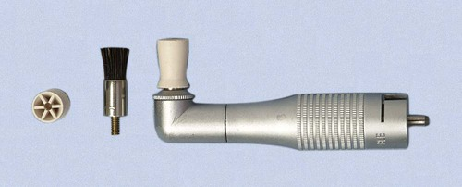
rubber cups:

Slide 36
6.Cutting instruments
Used for cutting and finishing of tooth structure and restoratives
Hand and rotary
-Hand cutting instruments: 2 families Chisels (push & pull) hatchet (right & left)

Slide 37
Chisels
Straight - bevels the cavosurface margin and used in 3, 4 and 5 classifications of cavities on the maxillary.
Wedelstaedt - only used in the anterior for classes 3, 4 and 5 as well.
Bin Angle - this is held in a pen grasp and used for class 2 maxillary only.

Slide 38
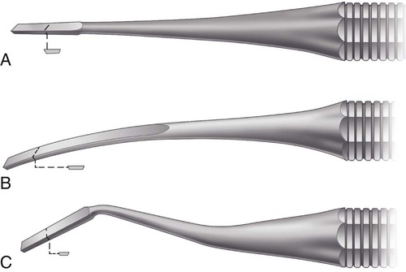
Straight chisel: used for cutting enamel and no need for right and left Bin-angle and Wedelstaedt chisels: cutting edge perpendicular to long axis of handle. used for cutting enamel.

Slide 39
Ordinary Hatchet excavator:
Primarily used on anterior teeth for preparing retentive areas and sharpen internal line angles for direct gold restorations.
Hoe excavator: planing walls and forming line angles in class III and IV for direct gold restorations.
Angle former: sharpen internal line angles and preparing retentive features for gold restorations
Spoon excavator: removal of caries, usually bin angled or triple angled to facilitate accessibility.

Slide 40
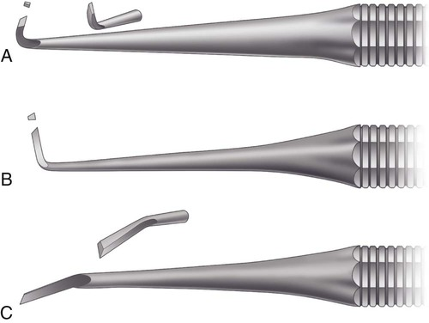
Ordinary , hoe and angle former:

Slide 41
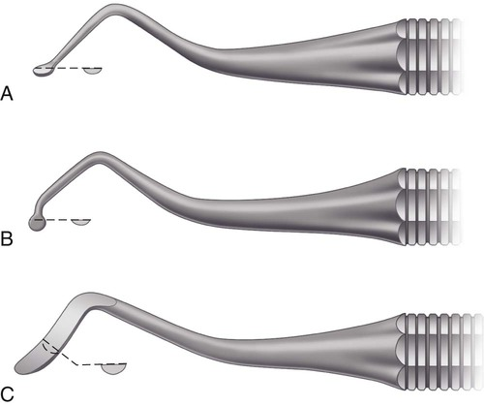
Spoon excavators: different angles..

Slide 42
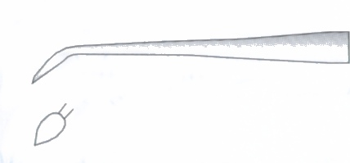
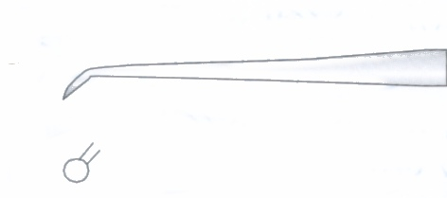
Cleoid-discoid: used for caving unset amalgam and burnishing inlay/onlay margins
Cleoid DISCOID

Slide 43
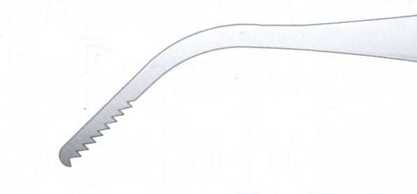
Knives: finishing knives, amalgam knives, gold knives. All used for trimming the excess filling materials at cavity margins.
Files: different size and shape also used for trimming the excess of filling material particularly at gingival margins.

Slide 44
-Rotary cutting instruments Operative burs: Flat fissure, pear-shaped, football, round, tapered, flame, chamfer, bevel, end cut, bud bur, steel, inverted cone, diamond, brown stone, and green-stone

Slide 45
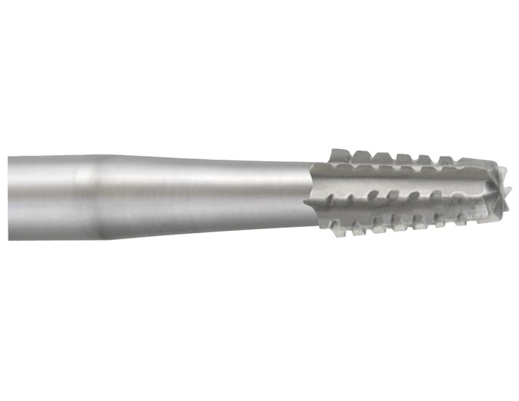
Fissure bur

Slide 46
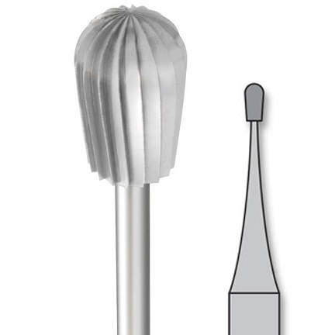
pear-shaped

Slide 47
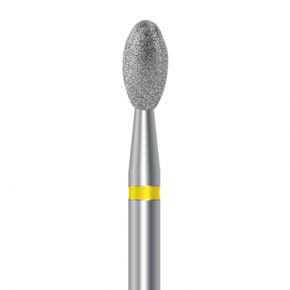
Football

Slide 48
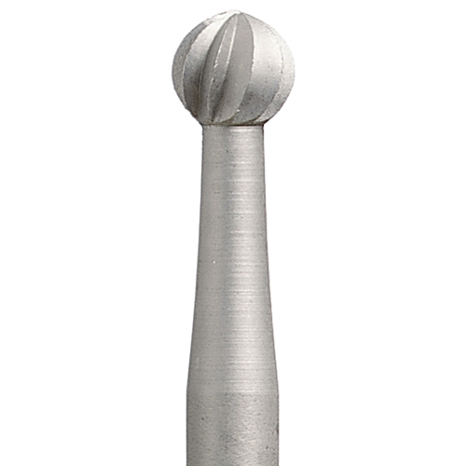
Round

Slide 49
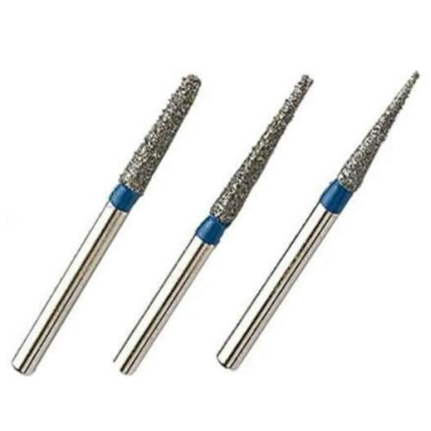
Tapered

Slide 50
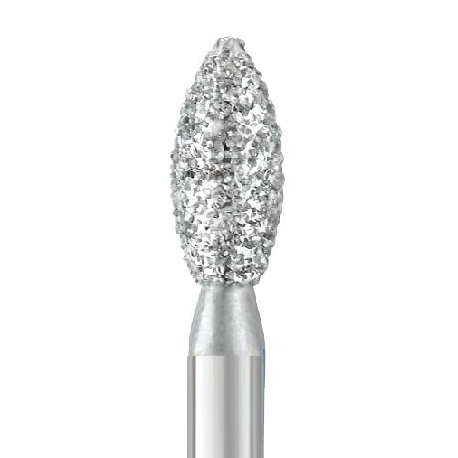
Flame

Slide 51
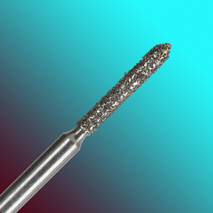
Chamfer

Slide 52
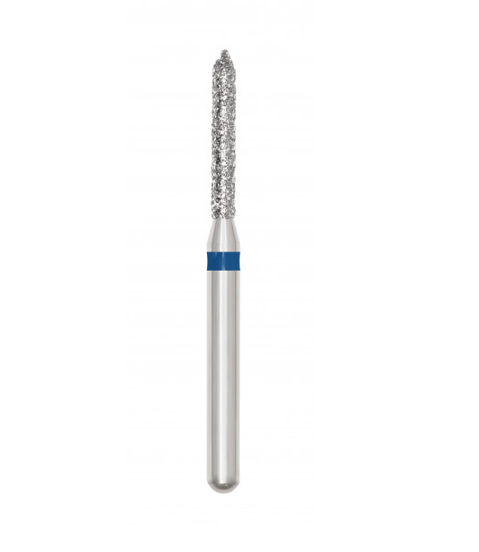
Bevel

Slide 53
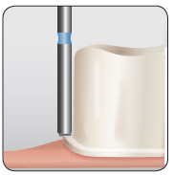
End cut

Slide 54
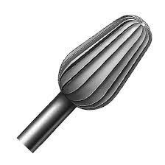
bud bur

Slide 55
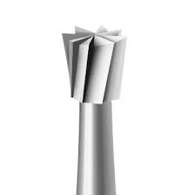
inverted cone

Slide 56
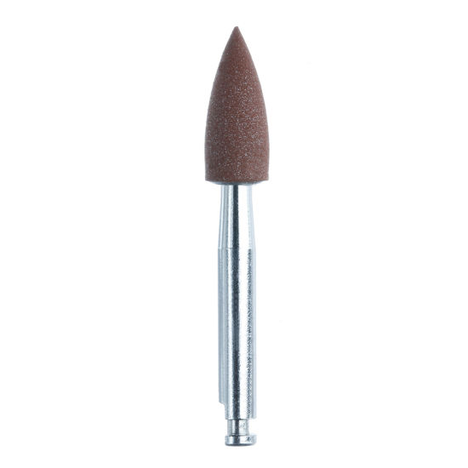
brown stone

Slide 57
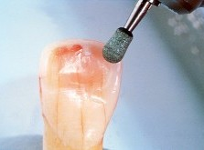
green-stone

Slide 58
THANK YOU

