Slide 1
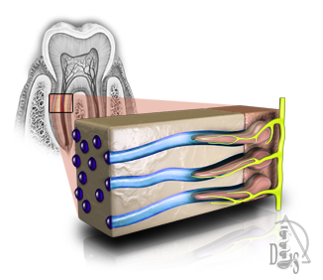
DENTIN
Dr. Hisham I. Wali
M.Sc. Conservative
Nov\3\2019

Slide 2
Dentin is the second hardest tissue in the human body.
Softer than enamel and harder than bone.
Dentin forms the largest portion of the tooth structure.
Covered by enamel in the crown.
Covered by cementum in the root.
Forms the walls of the pulp chamber.

Slide 3
Origin of dentin from mesoderm
Process of dentin formation:
dentinogenesis
Odontoblast
Odontoblasts are considered part of pulp
Dentin-pulp complex
Dentin is considered a living tissue

Slide 4
Composition of dentin
Composition of dentin
50% inorganic material
hydroxyapatite crystallites
20% Water
90% type I collagen
30% organic material
noncollagenous proteins
Increased resiliency
High organic content
Mineral phase
Age

Slide 5
Physical properties of dentin
Color
Yellow-white and slightly darker than enamel
In older patients, dentin is darker
Dentin can become brown or black when it has been exposed to oral fluids, old restorative materials
Dentin surfaces are more opaque and dull
Dentin is less reflective to light than similar enamel surfaces, which appear shiny

Slide 6
Physical properties of dentin
2. Hardness
Dentin is harder than bone or cementum.
Softer than Enamel
The hardness of dentin averages one-fifth that of enamel
Hardness near the dentinoenamel junction (DEJ) is about three times greater than near the pulp
Dentin becomes harder with age
Compressive strength and the modulus of elasticity of dentin is lower than that of enamel
Tensile strength of dentin is higher than that of enamel

Slide 7
Dentinal tubules
Dentinal tubules extend through the entire thickness of the dentin from the pulp to the DEJ.
The tubules follow an S-shaped path from the outer surface of the dentin to the perimeter of the pulp in coronal dentin.

Slide 8
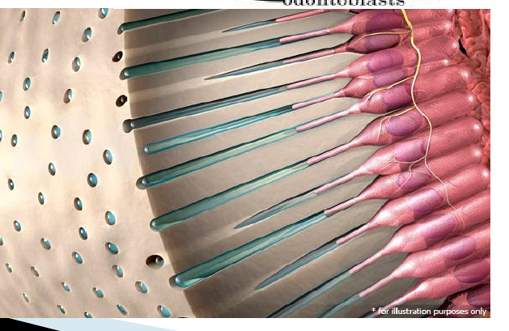
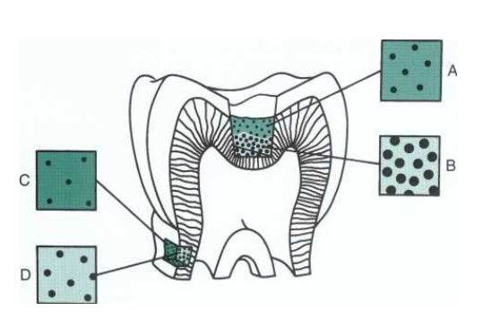
Dentinal tubules
Dentinal tubules are closer to each other at pulp border than they are at DEJ. WHY?
Surface area at DEJ is 5 times larger than that at pulp border
Dentinal tubules get larger as they approach pulp border

Slide 9
Predentin
Predentin is a band of newly formed, umnineralized matrix of dentin at the pulpal border of dentin.
Dentin
Predentin is formed in two stages: first, the organic matrix is deposited, and second, an inorganic mineral substance is added.
Mineralization occurs at the predentin-dentin junction (mineralization front).
Predentin

Slide 10
Classification of dentin
Development & formation
Primary Dentin
Secodary Dentin
Histological Basis
Peritubular Dentin
Intertubular dentin
Tertiary Dentin
Interglobular Dentin
Sclerotic dentin

Slide 11
Classification of dentin
Primary dentin
Forms the initial shape of the tooth.
It is usually completed 3 years after tooth eruption and before root completion.
Primary dentin is composed of mantle and circumpulpal dentin.
Mantle dentin is so named because it serves as a covering.
Mantle dentin is the first primary dentin formed.
Mantle dentin is deposited first at the DEJ and extends from the junction pulpward to the zone of interglobular or globular dentin.
A: Contour of Owen
B Mantle Dentin
C: Ciircumpulpal Dentin
D: S-Curve
E: DEJ

Slide 12
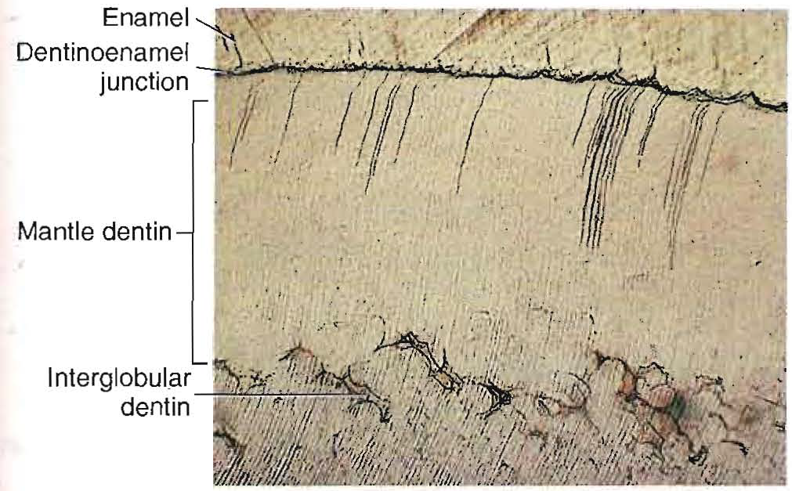
Classification of dentin
Primary dentin
Circumpulpal dentin directly underlies mantle dentin and comprises the bulk of the tooth's primary dentin
Circumpulpal dentin is thicker in crown portion than in the root portion of teeth

Slide 13
Classification of dentin
Secondary dentin
Secondary dentin forms internally to primary dentin of the crown and root.
It develops after the crown has come into clinical occlusal function and the roots are nearly completed.
Secondary dentin forms on all internal aspects of the pulp chamber.
In multi-rooted teeth, it tends to be thicker on the roof and floor than on the side walls.

Slide 14
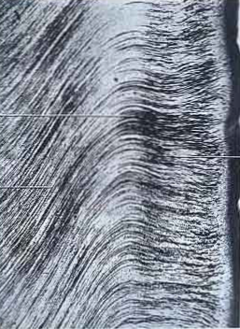
Classification of dentin
Primary dentin
Secondary dentin
During their course from primary to secondary dentin, dentinal tubules change their direction and the latter is histologically represented and called demarcation line
Demarcation line
secondary dentin

Slide 15
Classification of dentin
Tertiary dentin
Tertiary dentin results from pulpal stimulation and forms only at the site of odontoblastic activation
Activation may result from attrition, abrasion, caries, or restorative procedures
The quality (or architecture) and the quantity of tertiary dentin produced are related to the cellular response initiated, which depends on the intensity and duration of the stimulus
Tertiary dentin is sub classified as reactionary or reparative dentin, the former deposited by preexisting odontoblasts and the latter by newly differentiated odontoblast-like cells

Slide 16
Classification of dentin
Development & formation
Primary Dentin
Secodary Dentin
Histology Basis
Peritubular Dentin
Intertubular dentin
Tertiary Dentin
Interglobular Dentin
Sclerotic dentin

Slide 17
Classification of dentin
Peritubular or intratubular dentin
The dentinal matrix that immediately surrounds the dentinal tubule is termed intratubular or peritubular dentin
Peritubular dentin is present in tubules throughout dentin except near the pulp

Slide 18
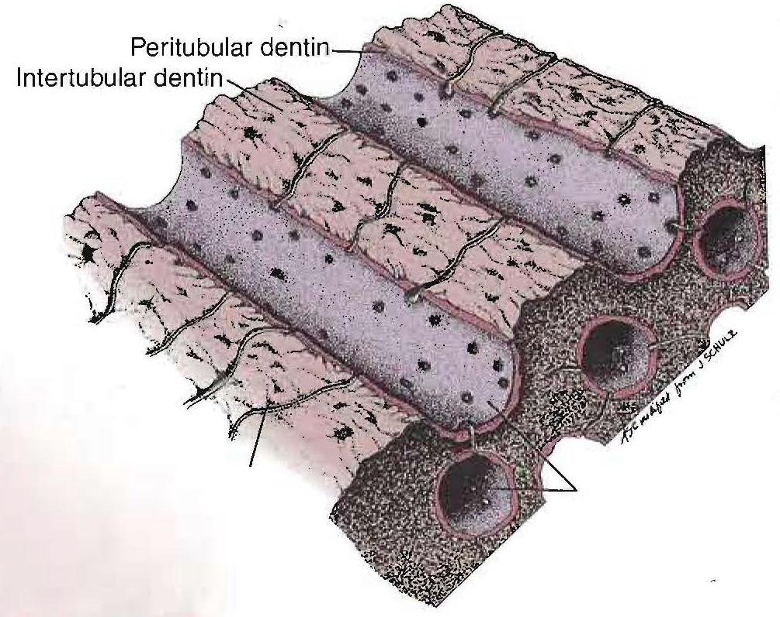
Classification of dentin
Peritubular or intratubular dentin
Diagram of dentinal.tubules showing peritubular and intertubular dentin. Note that side branches of dentinal tubules are in the intertubular dentin.
So called peritubular because it is a hypermineralized collar surrounding the tubules
However, because it is formed within and at the expense of the tubules, intratubular dentin is a more accurate term

Slide 19
Classification of dentin
Intertubular dentin
The main body of dentin is located between or around the dentinal tubules
Intertubular dentin is the body of dentin, which comprises the crown and root
Intertubular dentin, however, is less calcified than intratubular dentin

Slide 20
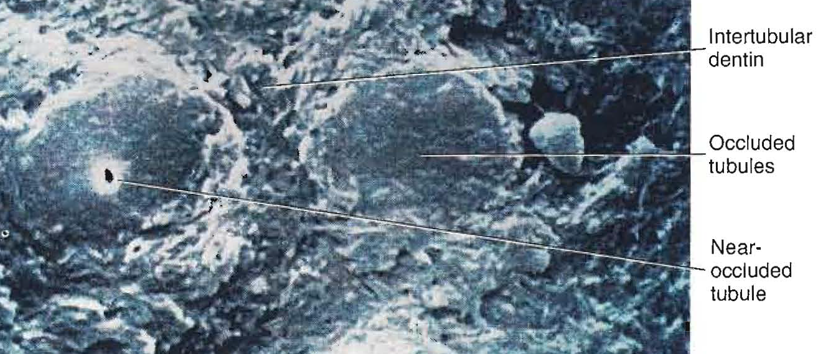
Classification of dentin
Sclerotic dentin
Sclerotic dentin describes dentinal tubules that have become occluded with calcified material.
Sclerotic dentin is harder, denser, and less sensitive.
The amount of sclerotic dentin increases with age.
Most common in the apical third of the root and in the crown midway between the DEJ and the surface of the pulp.

Slide 21
Classification of dentin
Sclerotic dentin
Sclerotic dentin can be subclassified into:
Physiologic sclerotic dentin: Sclerotic dentin occurs due to aging.
Reactive sclerotic dentin: Reactive sclerotic dentin occurs due to irritants.

Slide 22
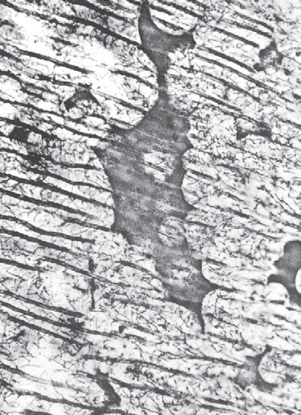
Classification of dentin
Interglobular dentin
Areas of unmineralized or hypomineralized dentin where globular zones of mineralization have failed to fuse into a homogeneous mass within mature dentin
Prevalent in human teeth in which the person has had a deficiency in vitamin D or exposure to high levels of fluoride at the time of dentin formation
Seen most frequently in the circumpulpal dentin just below the mantle dentin, where the pattern of mineralization is largely globular

Slide 23
Theories of pain transmission through dentin
Odontoblastic processes run inside dentinal tubules and extend through the dentin from the pulp to the DEJ.
These processes can be affected by various stimuli and thereby elicit pain
Cold air or water, mechanical contact by a probe or bur, and dehydration with cotton wool or a stream of air
Why does the patient feel pain when the dentist drills in dentin to make a cavity without anesthetizing his tooth?

Slide 24
Theories of pain transmission through dentin
Direct innervation theory
Transduction theory
Hydrodynamic theory

Slide 25
Theories of pain transmission through dentin
Three theories of dentin sensitivity. A suggests that the dentin is innervated directly. B suggests that the odontoblast acts as a receptor. C suggests that the receptors at the base of odontoblasts are stimulated directly or indirectly by fluid movement through the tubules.

Slide 26
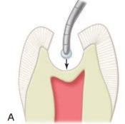
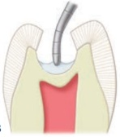
Dentin is a permeable hard tissue with tubules leading from the dentinoenamel junction to the pulp. Therefore, in cavity preparation, sealing of dentinal tubules is a requisite of effective restorative dentistry.

Slide 27
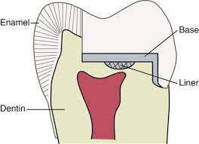
A metallic restoration, such as silver amalgam, is an excellent thermal conductor. Therefore, it is appropriate to place a cement base under it to protect the pulp by minimizing pain conduction.

Slide 28
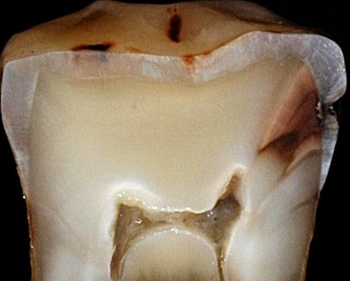
The spread of carious lesions is faster in dentin than enamel, why?
This is because of the low organic content of enamel in comparison to that of dentin. This Low organic content does not provide nutrient source for bacterial growth and acid production.

Slide 29
THANK YOU !

