Slide 1
DIGITAL RADIOGRAPHY
3rd grade-ishik university

Slide 2
DIGITAL RADIOGRAPHY
Digital image: An electronic image results from an electronic interaction (sensor in pt. mouth) with x-ray and processed by a computer.
There are two basic mechanisms of digital radiography:
1. Direct digital imaging: involves the use of a sensor that is directly wired to the computer, such as CCD.
2. Indirect digital imaging involve the use of photo-phosphor plates that are activated using x-ray ,then scanned in special devices that read the image. The image then displayed on the computer monitor, such as PSPP.

Slide 3
Direct digital imaging

Slide 4
Indirect digital imaging

Slide 5
Dental Imaging Examples
Intraoral devices
Panoramic dental systems
Head imaging
Cone Beam CT
Visible Light applications

Slide 6
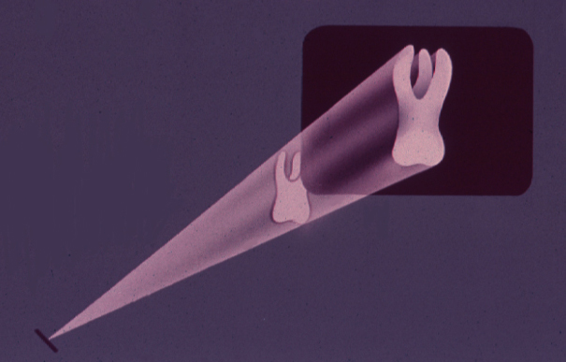
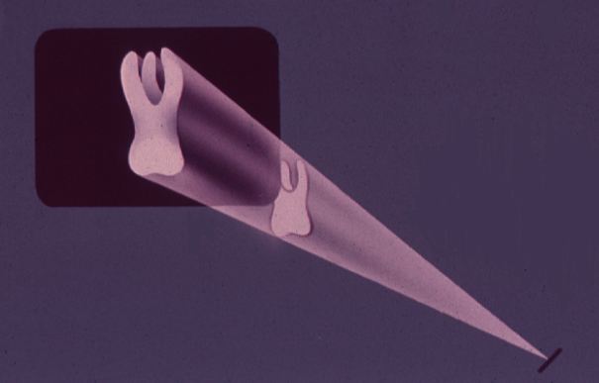
INTRAORAL X-RAY OPTIONS
IP
FILM
CCD
CMOS
CCD

Slide 7
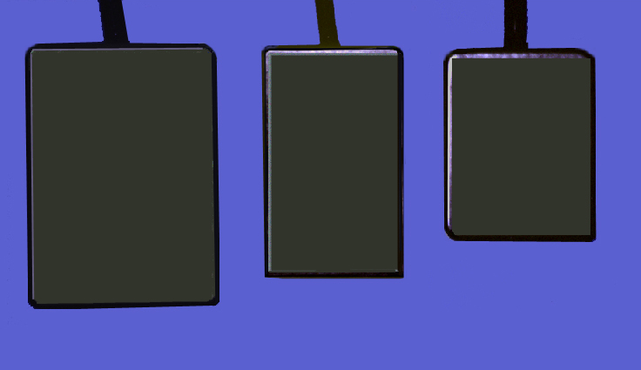
High Resolution = 22.5μ Standard = 45μ
Standard
&
High
Resolution
High
Standard
#2 #1 #0

Slide 9
Advantages/Disadvantages Radiographs vs. Digital Images
portable
not portable*
familiar
new technology*
can be viewed by all
must have hardware/software
initially inexpensive
inexpensive after initial investment
must send by mail
transmissible by wire*
one viewer or duplicate (duplitized)
viewed simultaneously

Slide 10
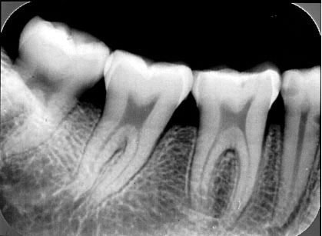
Advantages/Disadvantages Digital Images: new technology = uncertainty

Slide 11
Advantages/Disadvantages Digital Images: new technology = uncertainty

Slide 12
Advantages/Disadvantages Digital Images: new technology = uncertainty

Slide 13
Advantages/Disadvantages Digital Images: new technology = uncertainty

Slide 14
Advantages/Disadvantages Digital Images: new technology = uncertainty

Slide 15
Advantages/Disadvantages Digital Images: new technology = uncertainty

Slide 16
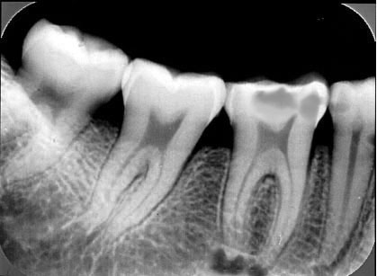
Advantages/Disadvantages Digital Images: new technology = uncertainty

Slide 17
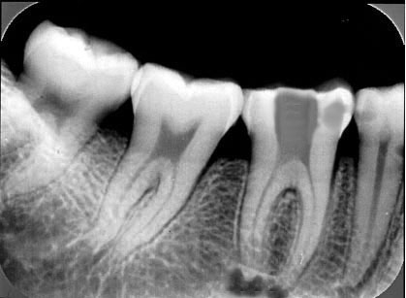
Advantages/Disadvantages Digital Images: new technology = uncertainty

Slide 18
Advantages/Disadvantages Digital Images: new technology = uncertainty

Slide 19
Advantages/Disadvantages Digital Images: new technology = uncertainty

Slide 20
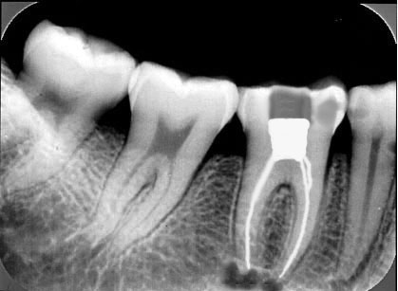
Advantages/Disadvantages Digital Images: new technology = uncertainty

Slide 21
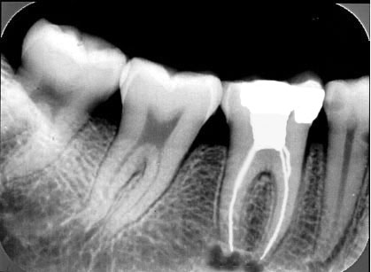
Advantages/Disadvantages Digital Images: new technology = uncertainty

Slide 22
Advantages/Disadvantages Digital Images: new technology = uncertainty

Slide 23
Advantages/Disadvantages Radiographs vs. Digital Images
no inherent measurements
software driven measurements
film size similar to beam size
receptor size smaller than beam size (DR/cable systems)
film covers larger area
receptor covers smaller area (DR/cable systems)

Slide 24
Advantages/Disadvantages Radiographs vs. Digital Images
EPA film disposal
no film disposal
EPA chemical/silver disposal/recovery
no chemicals
film placement is easy
cable connection interferes with placement (CCD)
easy to view multiple images (shuffling)
awkward to view multiple images (shuffling)

Slide 25
Advantages/Disadvantages Radiographs vs. Digital Images
caries detection
caries detection*
periodontal bone loss
periodontal bone loss
periapical bone loss
periapical bone loss
complete mouth survey
complete mouth survey*
bony lesions
bony lesions
poor for soft tissue lesions
soft tissue lesions?

Slide 26
Status of Current Technology (500 dentist)
30 + different brands of equipment are in use
61% of dentist paid $ 10,000 - $ 30,000 for the system
76% of the dentist in USA would purchase the same system
again
80% of dentist in USA reported that the image quality and
diagnostic capabilities were similar to or better than
conventional radiology
Image enhancement tools used most were: magnify,
enhance, contrast and inverse

Slide 27
Status of Current Technology (500 dentist)
Major advantages: instant image, patient communication,
image enhancement, no processing, less radiation,
image magnification
Major disadvantages: high cost, uncomfortable sensors,
poor image quality, difficult to learn and implement,
dependent on computer, technical problems
89% of dentist in USA using digital radiology
recommended that colleagues switch to digital now rather
than continue to wait

Slide 28
Filmless Imaging
1895: Wilhelm Conrad Roentgen → X-rays
Two weeks after: Otto Walkoff: First dental x-ray
ALARA principle
“As low as reasonably achievable”
1980: First digital x-ray sensor for use in dentistry
2006: End of the film-base radiology?

Slide 29
Digital Imaging:
Most significant advantages:
- Computer-aided image interpretation
- Image enhancement
- Image archiving
- Image retrieval

Slide 30
Digital Imaging
More Advantages
Chemical processing
Hazardous wastes
Images can be transferred electronically
Patient Education
Time
Less Radiation
One thousand more depending of the vendor

Slide 31
Digital Imaging
Disadvantages
Cost
Susceptible to use and abuse
Obsolete very fast
System crash
Same geometry limitations than conventional
radiology
- Storage and back up

Slide 32
THANK YOU

