Slide 1
CHAPTER 3
RADIOBIOLOGY
Radiobiology : is the study of the effects of ionizing radiation on living systems.
29.10.2017

Slide 2
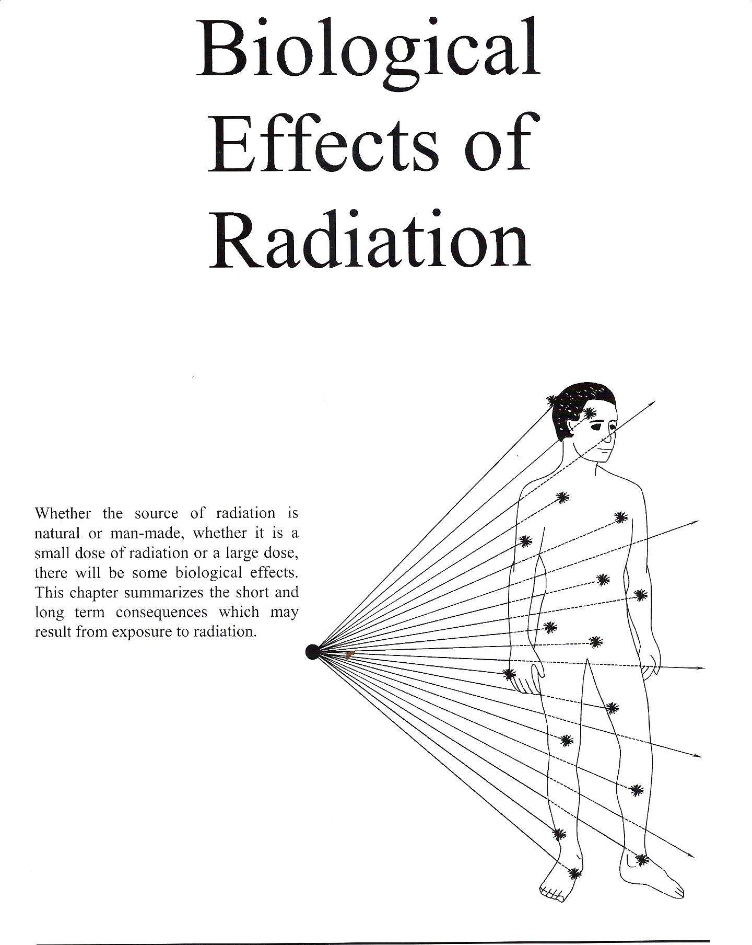

Slide 3
Radiation Causes Ionizations of:
ATOMS
which may affect
MOLECULES
which may affect
CELLS
which may affect
TISSUES
which may affect
ORGANS
which may affect
THE WHOLE BODY

Slide 4
The initial interaction between ionizing radiation and matter occurs at the level of the electron within the first 10⁻¹³ second after exposure.
These changes result in modification of biologic molecules within the ensuing seconds to hours.
In turn, the molecular changes may lead to alterations in cells and organisms that persist for hours, decades, and possibly even generations.
These changes may result in injury or death.

Slide 5
Radiation Chemistry
Radiation acts on living systems through direct and indirect effects.
When the energy of a photon or secondary electron ionizes biologic macromolecules, the effect is termed direct effect.

Slide 6
Alternatively, a photon may be absorbed by water in an organism, ionizing some of its water molecules.
The resulting ions form free radicals (radiolysis of water) that in turn interacts and produce changes in biologic molecules.
Because intermediate changes involving water molecules are required to alter the biologic molecules, this series of events is termed indirect effect.

Slide 7
DIRECT EFFECT
If radiation interacts with the atoms of the DNA molecule, or some other cellular component critical to the survival of the cell, it is referred to as a direct effect.
Such an interaction may affect the ability of the cell to reproduce and, thus, survive.

Slide 8
If enough atoms are affected such that the chromosomes do not replicate properly, or if there is significant alteration in the information carried by the DNA molecule,
Then the cell may be destroyed by “direct” interference with its life-sustaining system.

Slide 9
Approximately one third of the biologic effects of x-ray exposure result from direct effects.
However, direct effects are the most common outcome for particulate radiation such as neutrons and α particles.

Slide 10
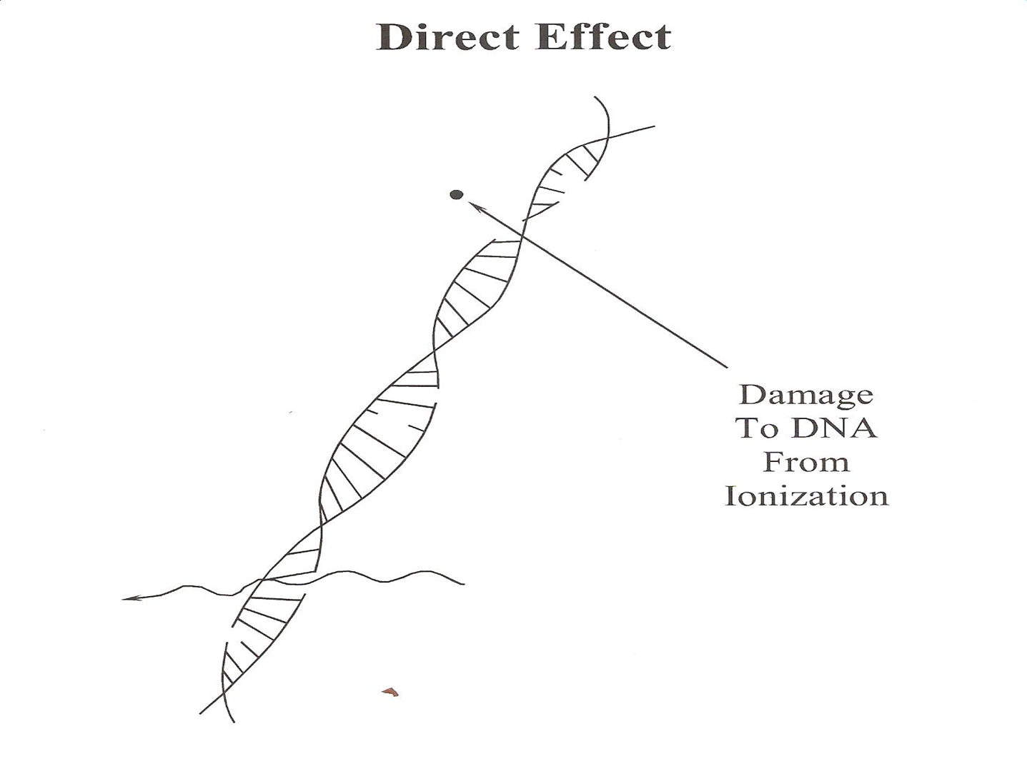

Slide 11
INDIRECT EFFECTS
If a cell is exposed to radiation, the probability of the radiation interacting with the DNA molecule is very small since these critical components make up such a small part of the cell.
However, each cell, just as is the case for the human body, is mostly water(about 70% by weight).

Slide 12
Therefore, there is a much higher probability of radiation interacting with the water that makes up most of the cell’s volume.
About two thirds of radiation-induced biologic damage results from indirect effects.

Slide 13
When radiation interacts with water, it may break the bonds that hold the water molecule together, producing fragments such as hydrogen (H) and hydroxyls (OH).
These fragments may recombine or may interact with other fragments or ions to form compounds, such as water, which would not harm the cell.
However, they could combine to form toxic substances, such as hydrogen peroxide (H2O2), which can contribute to the destruction of the cell.

Slide 14
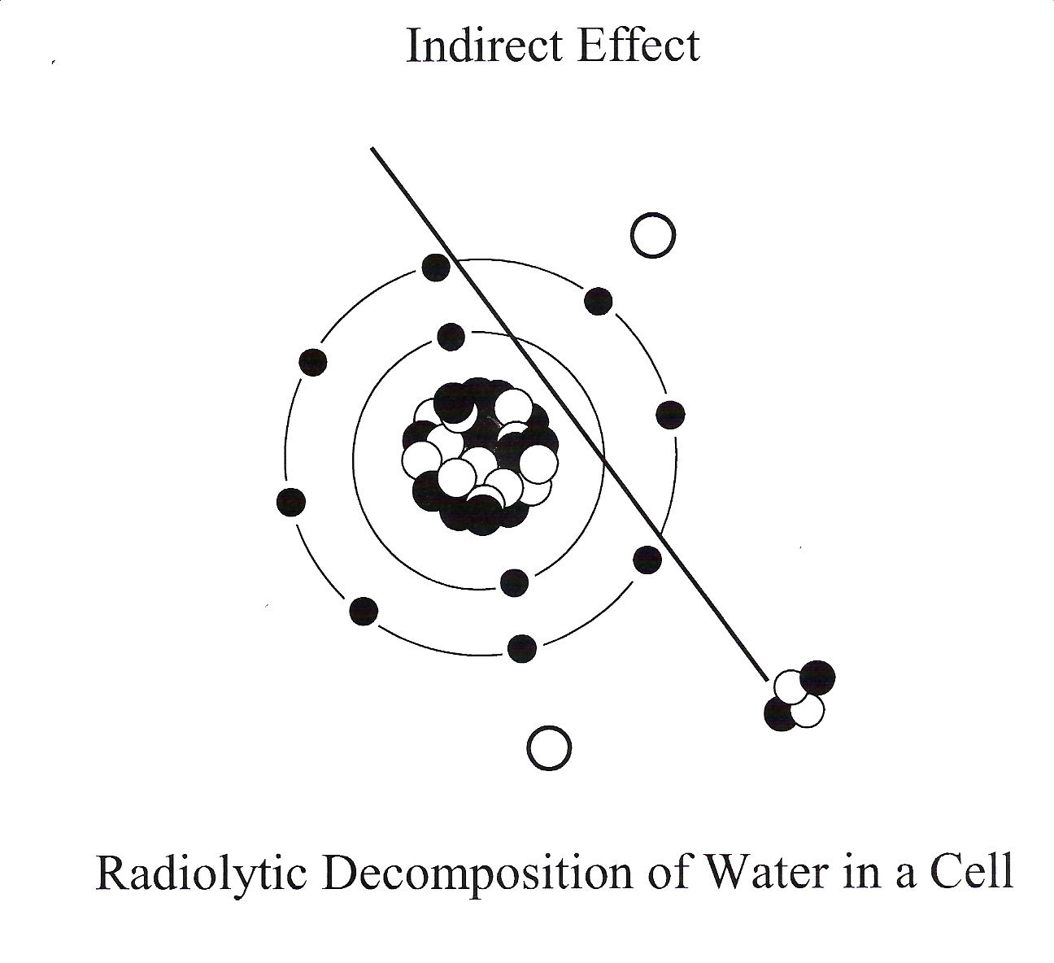

Slide 15
CHANGES IN DEOXYRIBONUCLEIC ACID
Damage to a cell ’s deoxyribonucleic acid (DNA) is the primary cause of
(1) radiation-induced cell death,
(2) heritable (genetic) mutations,
and (3) cancer formation (carcinogenesis).

Slide 16
Radiation produces a number of different types of alterations in DNA, including the following:
1-Breakage of one or both DNA strands
2-Cross-linking of DNA strands within the helix to other DNA strands or to proteins
3-Change or loss of a base
4- Disruption of hydrogen bonds between DNA strands

Slide 17
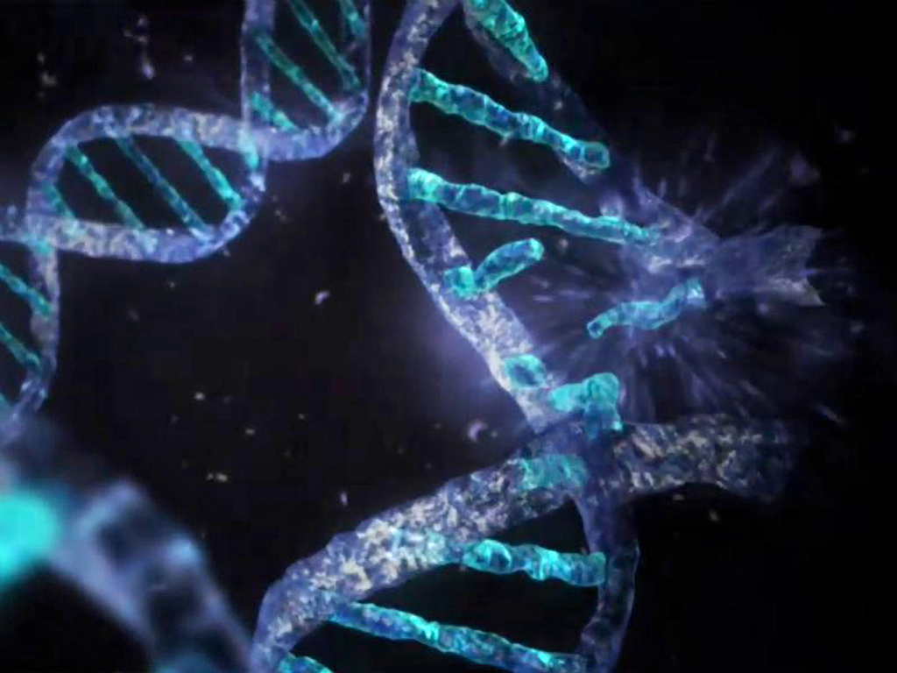

Slide 18
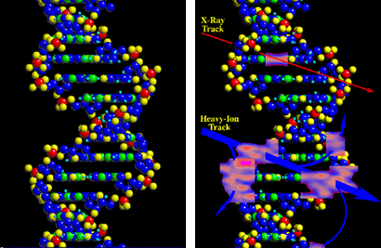

Slide 19
Radiosensitivity of various cells
Not all living cells are equally sensitive to radiation.
Those cells which are actively reproducing are more sensitive than those which are not.
This is because dividing cells require correct DNA information in order for the cell’s offspring to survive.

Slide 20
A direct interaction of radiation with an active cell could result in the death or mutation of the cell,
whereas a direct interaction with the DNA of a dormant cell would have less of an effect.

Slide 21
As a result, living cells can be classified according to their rate of reproduction, which also indicates their relative sensitivity to radiation.
This means that different cell systems have different sensitivities.

Slide 22
Lymphocytes (white blood cells) and cells which produce blood are constantly regenerating, and are, therefore, the most sensitive.
Reproductive and gastrointestinal cells are not regenerating as quickly and are less sensitive.
The nerve and muscle cells are the slowest to regenerate and are the least sensitive cells.

Slide 23
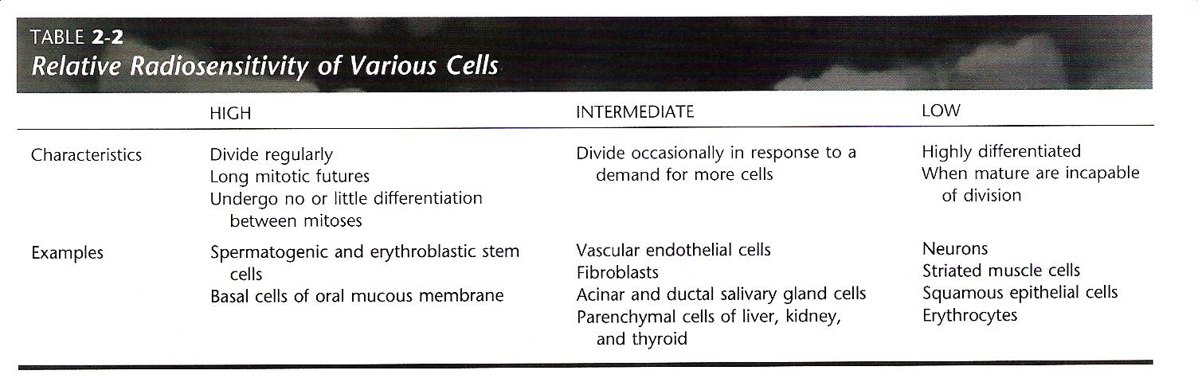

Slide 24
Cellular effects of radiation
Cells, like the human body, have a tremendous ability to repair damage.
As a result, not all radiation effects are irreversible. In many instances, the cells are able to completely repair any damage and function normally.
If the damage is severe enough, the affected cell dies.

Slide 25
In some instances, the cell is damaged but is still able to reproduce. The daughter cells, however, may be lacking in some critical life-sustaining component, and they die.
The other possible result of radiation exposure is that the cell is affected in such a way that it does not die but is simply mutated. The mutated cell reproduces and thus perpetuates the mutation. This could be the beginning of a malignant tumor

Slide 26
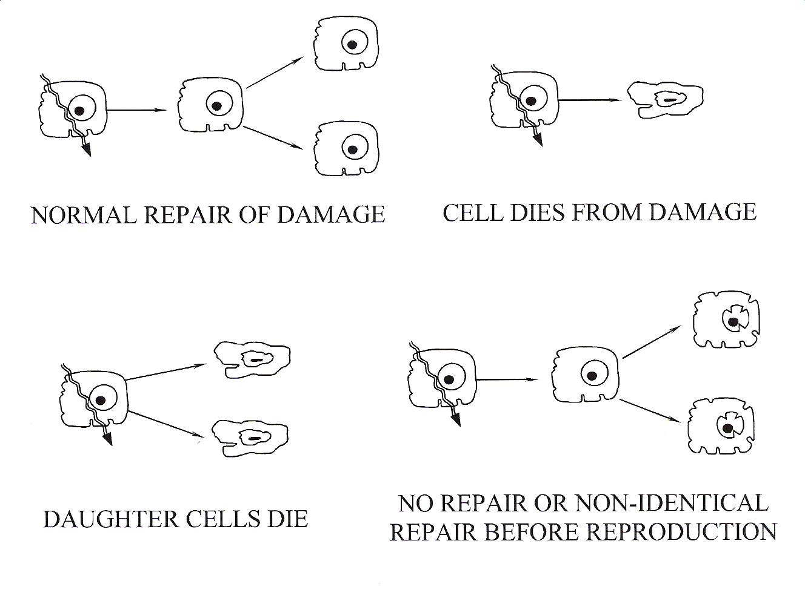
Cellular effects of radiation

Slide 27
Radiosensitivity of organs
The sensitivity of the various organs of the human body correlate with the relative sensitivity of the cells from which they are composed.
For example, since the blood forming cells were one of the most sensitive cells due to their rapid regeneration rate, the blood forming organs are one of the most sensitive organs to radiation.
Muscle and nerve cells were relatively insensitive to radiation, and therefore, so are the muscles and the brain.

Slide 28
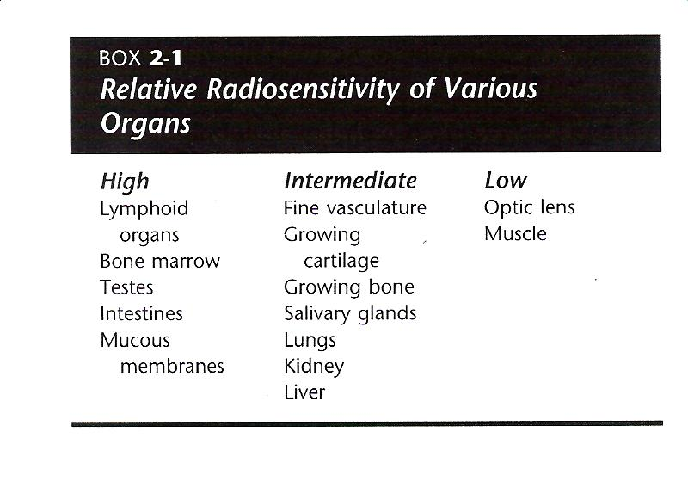

Slide 29
RADIATION EFFECTS ON EMBRYOS AND FETUSES
Embryos and fetuses are considerably more radiosensitive than adults because most embryonic cells are relatively undifferentiated and rapidly mitotic.
Exposures in the range of 2 to 3 Gy during the first few days after conception are thought to cause undetectable death of the embryo.

Slide 30
The cells in the embryo are dividing rapidly and are highly sensitive to radiation.
Lethality is common and many of these embryos fail to implant in the uterine wall.
The first 15 weeks includes the period of organogenesis when the major organ systems form.

Slide 31
The most common abnormalities among the Japanese children exposed early in gestation were reduced growth that persists through life and reduced head circumference (microcephaly), often associated with mental retardation.
Other abnormalities included small birth size, cataracts, genital and skeletal malformations, and microphthalmia.

Slide 32
The period of maximal sensitivity of the brain is 8 to 15 weeks after conception.
The frequency of severe mental retardation after exposure to 1 Gy during this period is about 43%. These effects are believed to have a threshold of about 0.1 to 0.2 Gy.
This threshold dose is 400 to 800 times higher than the exposure from a dental examination (0.25 mGy from a full-mouth examination when a leaded apron is used).

Slide 33
CARCINOGENESIS
Radiation causes cancer by modifying DNA.
The most likely mechanism is radiation-induced gene mutation.
Most investigators think that radiation acts as an initiator, that is, it induces a change in the cell so that it no longer undergoes terminal differentiation.

Slide 34
Evidence also exists that radiation acts as a promoter, stimulating cells to multiply.
Finally, it may also convert premalignant cells into malignant ones, for instance, conversion of proto-oncogenes to oncogenes.

Slide 35
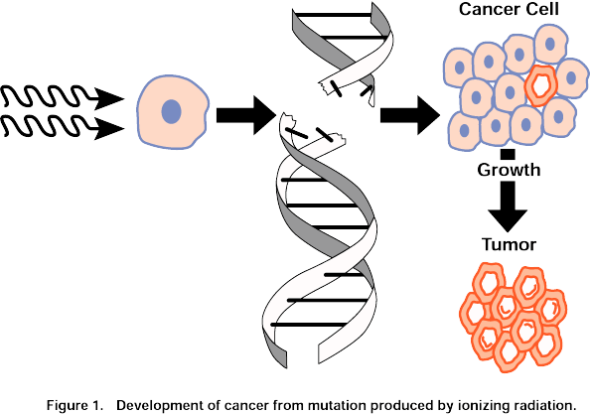

Slide 36
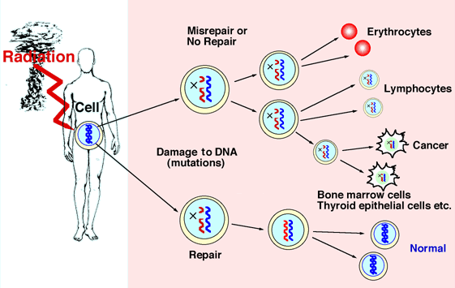

Slide 37


