Slide 1
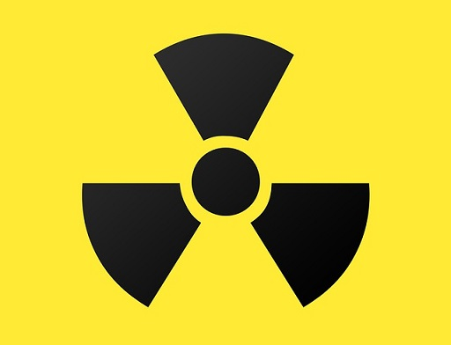
C H A P T E R 4
Radiation Safety and Protection
05.10.2017

Slide 2
Sources of Radiation Exposure
The general population is exposed to radiation from:
1- Natural Sources
2- Man made Sources

Slide 3
I -NATURAL RADIATION - All life on earth has evolved in a continuous exposure to natural radiation from: 1. Cosmic 2. Terrestrial sources - An average annual effective dose of about 2.4 mSv worldwide and 3.0 mSv in the United States because of higher radon levels.

Slide 4
1- Cosmic Sources - Includes:- 1. Energetic subatomic particles, 2. Photons from the sun & supernova, 3. The particles & photons generated by the interactions of primary cosmic radiation with atoms and molecules of the earth’s atmosphere.

Slide 5
Cosmic rays

Slide 6
- Exposure from cosmic radiation is primarily a function of altitude,
- almost doubling with each 2000-meter (m) increase in elevation, because less atmosphere is present to attenuate the radiation.

Slide 7
- At sea level the exposure from cosmic radiation is about 0.24 mSv per year; - at an elevation of 1600 m (1 mile, the elevation of Denver, Colorado), it is about 0.50 mSv per year. - The global average is 0.4 mSv per year, about 16% of natural exposure.

Slide 8
2-Terrestrial Sources
Exposure from terrestrial sources comes from:
(a) external sources such as soil and from,
(b) internal sources, including radon and other radionuclides that are inhaled or ingested.

Slide 9
2-Terrestrial Sources

Slide 10
A-External Radiation.
- Exposure from terrestrial sources comes from radioactive nuclides in the soil, primarily potassium 40 and the radioactive decay products of uranium 238 and thorium 232.
- Most of the γ radiation from these sources comes from the top 20 cm of soil.
- The average terrestrial exposure rate is about 0.5 mSv per year, or approximately 20% of the average annual background exposure.

Slide 11
B-Internal radiation
- Radon. Radon, a decay product in the uranium series, is estimated to be responsible for approximately 52% of the radiation exposure of the world ’s population about (1.2 mSv).
- Radon is a gas (radon 222) that enters homes and buildings and by itself does little harm.

Slide 12
However, radon decays to form solid products that emit α particles
- These decay products become attached to dust particles that can be inhaled and deposited on the bronchial epithelium in the respiratory tract.
- Exposure to this quantity of radiation may cause as many as 10,000 to 20,000 lung cancer deaths per year in the United States, mostly in smokers.

Slide 13
Other sources of internal terrestrial exposure
are radionuclides that are taken up from the external environment by ingestion of uranium and thorium.
- The total exposure from ingestion and inhalation other than radon is estimated at 0.3 mSv per year, about 12% of natural-origin exposure.

Slide 16
II- MAN-MADE RADIATION
Humans have contributed many additional sources of radiation to the environment .

Slide 17
II- MAN-MADE RADIATION

Slide 18
These may be categorized into three major groups:
(1) medical diagnosis and treatment,
(2) consumer and industrial products and sources,
and (3) other minor sources.

Slide 19
1- Medical Diagnosis and Treatment
-This source of exposure contributes the large majority of exposures from man-made sources.
- Although sources in this group include radiation therapy and nuclear medicine, diagnostic medical exposure is the largest contributor, contributing most of this source.
- Dental x-ray examinations are responsible for less than 1% of the average annual exposures from man-made sources.

Slide 20
2-Consumer and Industrial Products
This group includes: the domestic
water supply, tobacco products,
combustible fuels, dental porcelain,
television receivers, pocket watches,
smoke alarms, and airport inspection systems
& contributes only a small proportion of the total average annual man-made exposure.

Slide 21
3-Other Man-made Sources
- Individuals who work at medical and dental x-ray facilities, mining or milling or with nuclear weapons are occupationally exposed to additional radiation exposure.
- Another source is the nuclear fallout from the nuclear weapons testing in the 1950s and early 1960s.

Slide 22
- Nuclear power (which contributes only about 0.01 mSv to the average annual exposure) is another man-made source of particular concern to the public.
-But accidents have occurred, between 1945 and 1987, 284 nuclear reactor accidents, excluding Chernobyl, were reported in several countries.

Slide 25
DOSE LIMITS
There 2 organization NCRP (National Council on Radiation Protection and Measurements) & ICRP(International Commission on Radiological Protection) .
Dentists and their staff are occupationally exposed workers and are allowed to receive up to 50 mSv of whole-body radiation exposure per year.
The average dose for individuals occupationally exposed in the operation of dental x-ray equipment is far less than the limit: 0.2 mSv, or 0.4% of the allowable exposure.

Slide 28
Reducing Dental Exposure
- There are three guiding principles in radiation protection;
- The first is the principle of justification, the dentist must do more good than harm.
-The second guiding rule is the principle of optimization. ALARA
- The third principle is that of dose limitation.

Slide 29
PATIENT SELECTION CRITERIA
According to (ADA, 2006)
-Dentists should not prescribe routine dental radiographs at preset intervals for all patients. Instead,
- they should prescribe radiographs after an evaluation of the patient ’s needs that includes
a(1) health history
review, a (2)clinical dental history assessment, a (3) clinical examination, and an (4) evaluation of susceptibility to dental diseases

